Slide 1
Prediction of Health Insurance Premium in the United states
GROUP #19
Prateek Kaushik,
Prashant Dhungana,
Nisha Pillai,
Mariya Mathews

Slide 2
INTRODUCTION
Dataset
Objective: Predicting Insurance Premiums
Methodology: Beyond Additive Models
Exploration: Interactions and Higher-Order Variables
Ultimate Goal: Informed Healthcare Financial Planning

Slide 3
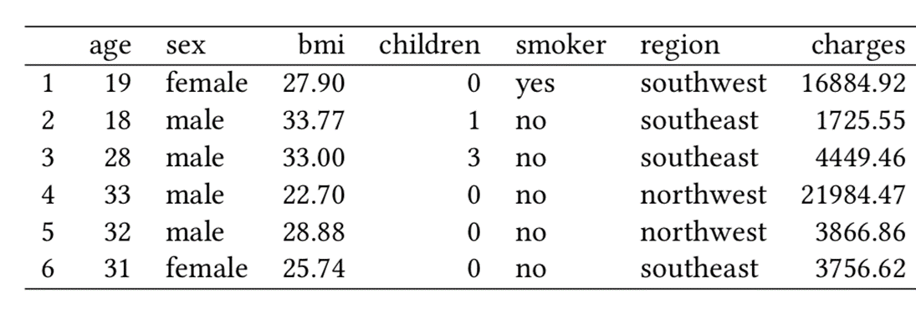
DATASET
Response Variable:
Charges: Insured individual medical annual costs billed by the health insurance in USD($) . (Quantitative)
Predictor Variables:
Age: Age of the primary Insured. (Quantitative)
Sex: Insured gender “Male or Female”. (Qualitative)
BMI: Body Mass Index. (Quantitative)
Children: Insured number of dependents. (Quantitative)
Smoker: Insured smoking habits “Yes or No”. (Qualitative)
Region: Insured region of residence “Southwest”, ”Southeast”, “Northwest”, “Northeast”. (Qualitative)
Reference: KAGGLE

Slide 4
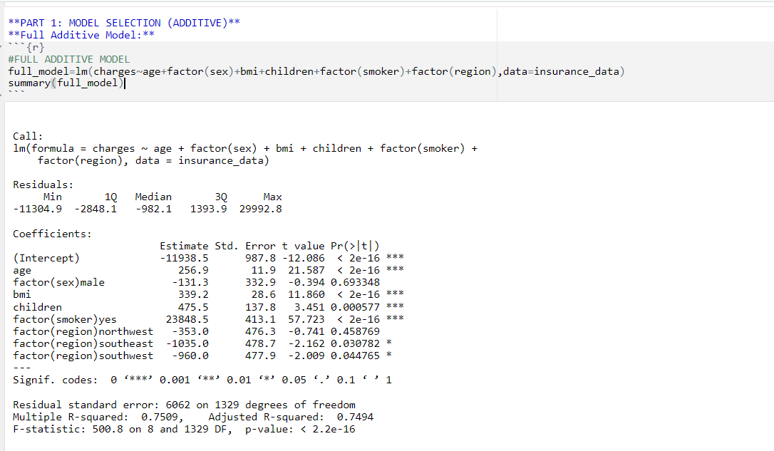
PART 1: MODEL SELECTION

Slide 5
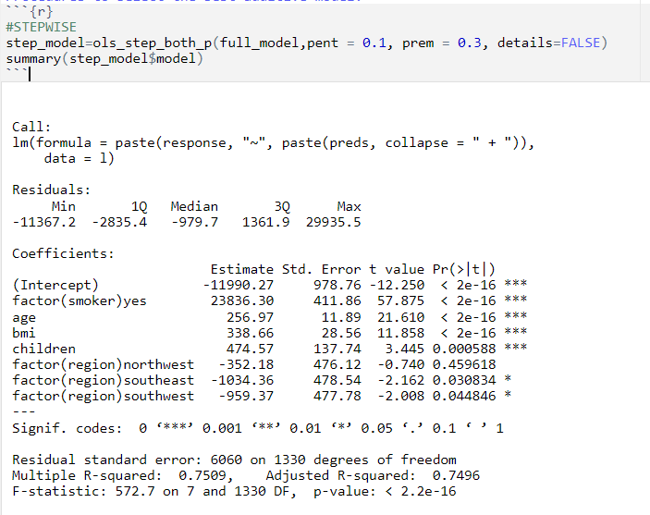
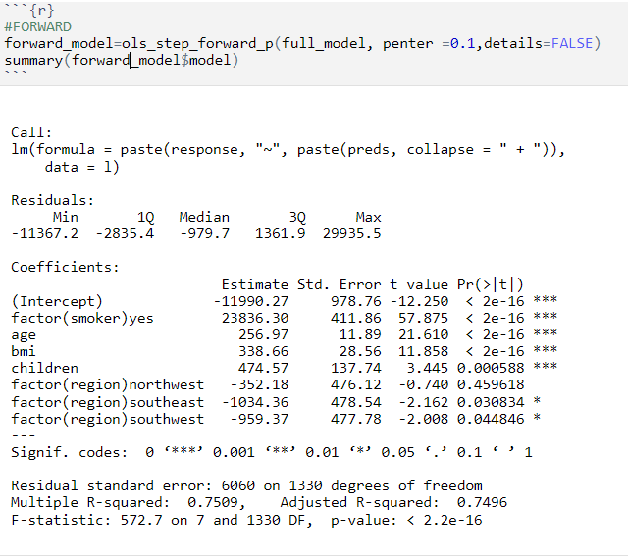
Stepwise, Forward and Backward

Slide 6
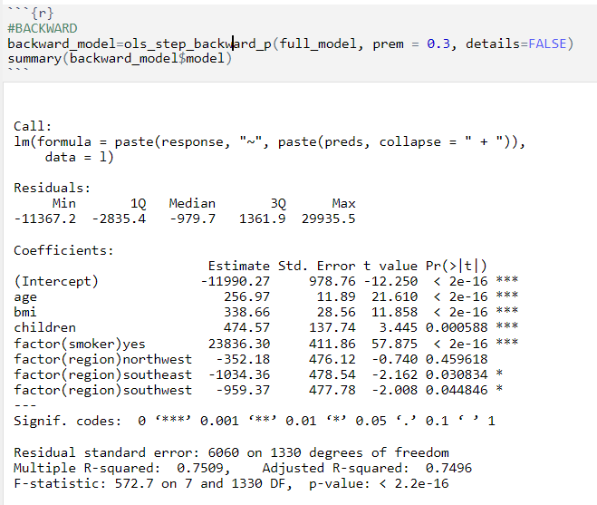
Same results for using Stepwise, Forward and Backward Selection Procedure.
The predictor variable “sex” is not statistically significant.
Reduce the model with the exclusion of predictor variable sex.

Slide 7

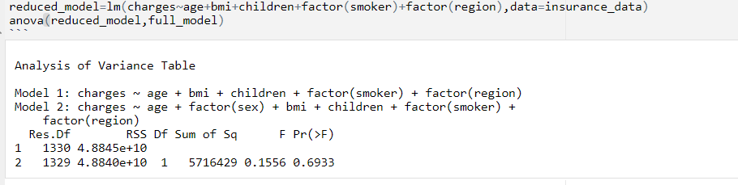
F-Test (Reduced vs Full)

Slide 8

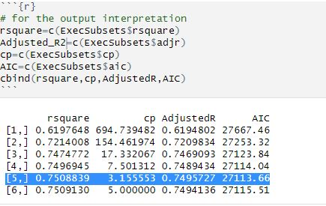
All Possible Regression Selection Procedure

Slide 9
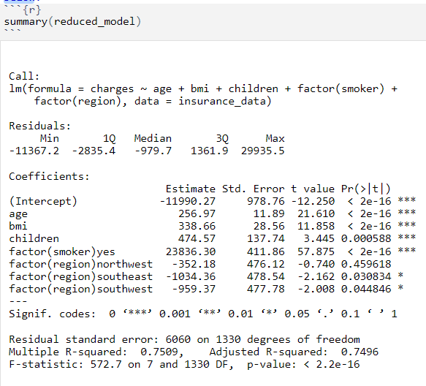
BEST ADDITIVE MODEL
Charges=β0+ β1×Age+ β2×BMI+ β3×Children+ β4×Smokeryes+ β5×Regionnorthwest+ β6×Regionsoutheast+ β7×Regionsouthwest
​

Slide 10
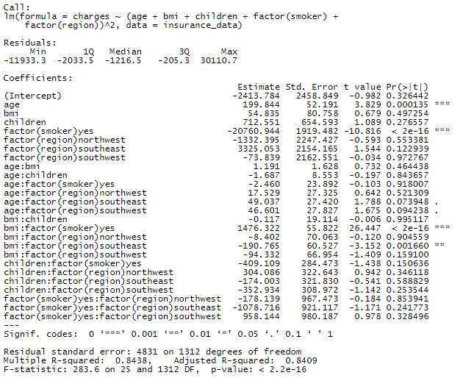
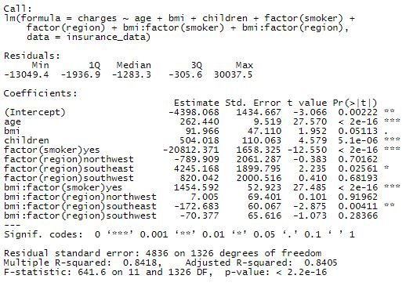
PART 2: MODEL WITH INTERACTION

Slide 11
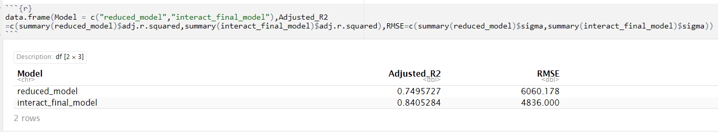
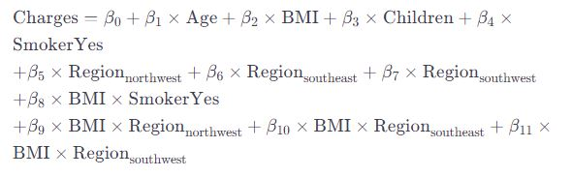
ADDITIVE vs INTERACTION MODEL
Best Model:

Slide 12
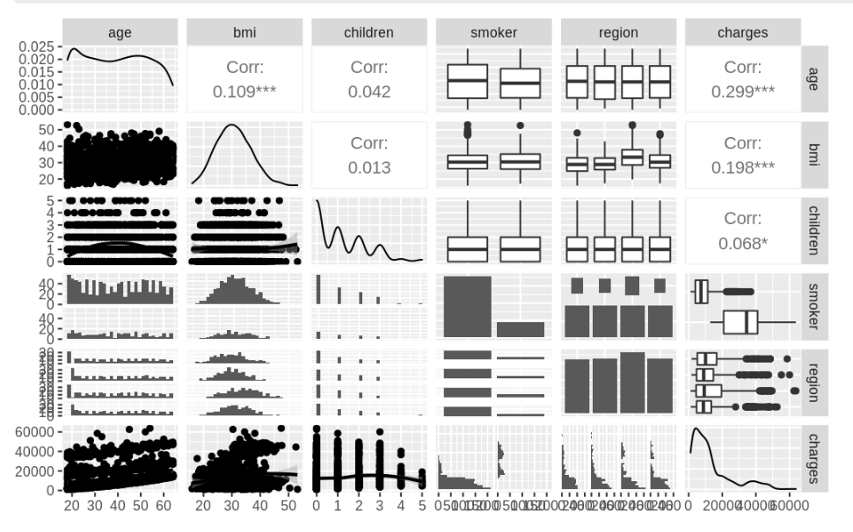
PART 3: HIGHER ORDER MODEL

Slide 13

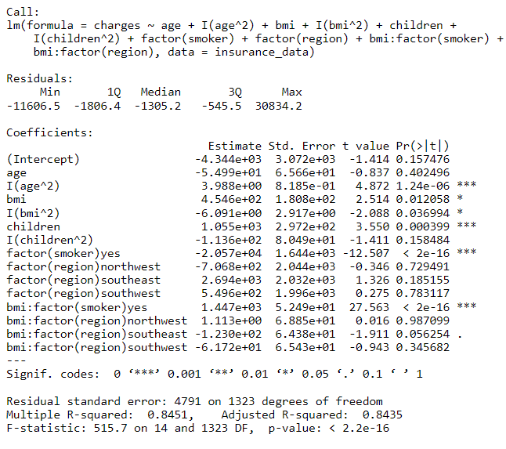
PART 3: HIGHER ORDER MODEL
Individual Coefficient T-test at significance level of alpha=0.05
The only significant higher order terms are I(age^2) and I(bmi^2).
So we move to create a cubic model on the significant predictors from the quad_model.

Slide 14
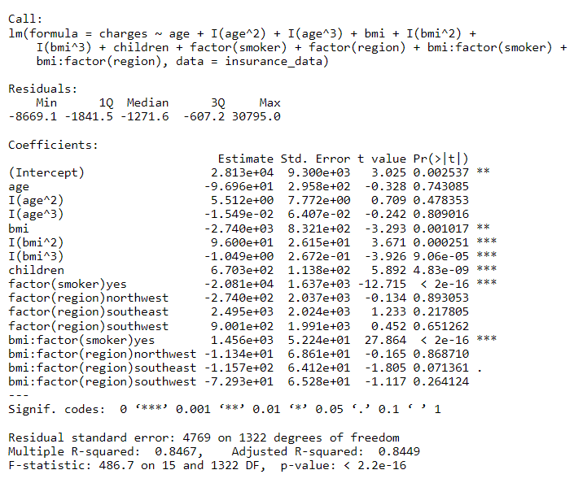
Age becomes insignificant for the cubic term
Cubic term for BMI is still significant.
So we move on to create another model with fourth power on bmi while leaving age at the second order.

Slide 15
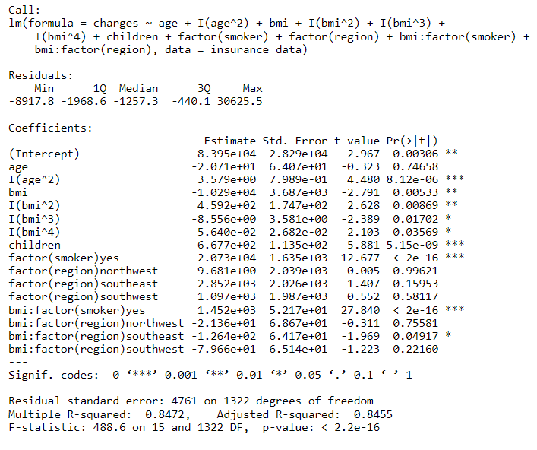
We increase the power to five now for BMI since the fourth power is still significant.

Slide 16
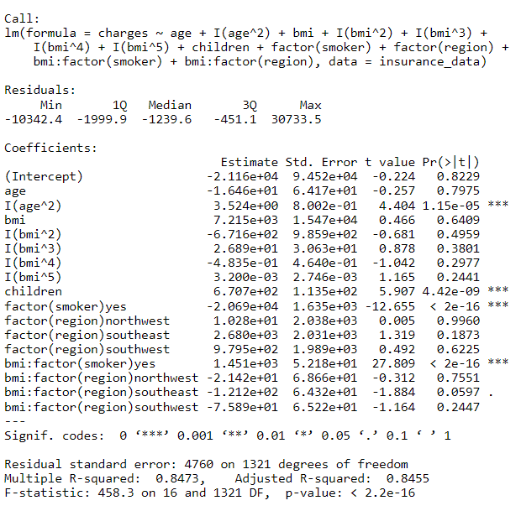
The power to the five becomes insignificant for the BMI.
Therefore the model with the fourth order term is the most significant higher order model so far.
Now we compare the adjusted_r2 and rmse to find the best higher order model.

Slide 17
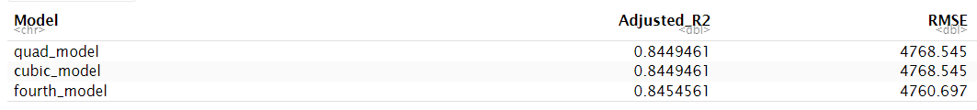
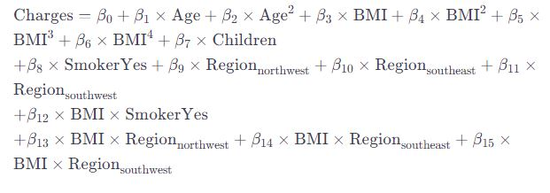
COMPARE HIGHER ORDER MODELS
The fourth_model has the highest adjusted_r2 with lowest rmse therefore this model is the best higher order model.

Slide 18

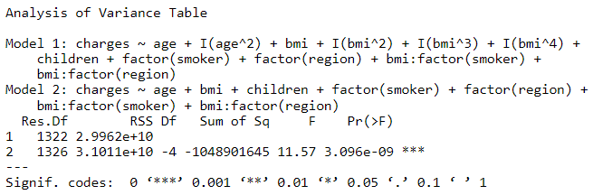
F-TEST: HIGHER ORDER vs INTERACTION MODEL
We reject the null hypothesis suggesting that the higher order terms added are statistically significant. Therefore the best model so far is the higher order model (fourth_model) which has a I(age^2) and bmi is up to the power of 4.

Slide 19

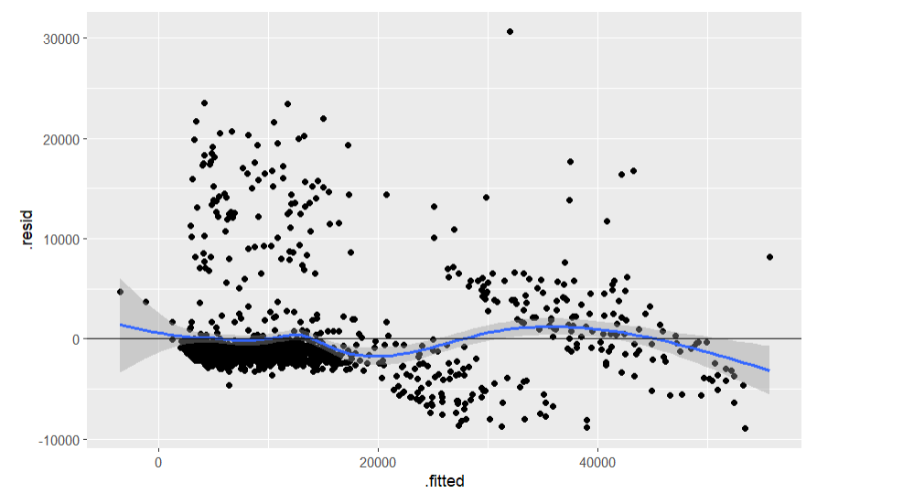
Part 4: Regression Assumptions
Linearity Assumption
Residual vs fitted plot

Slide 20
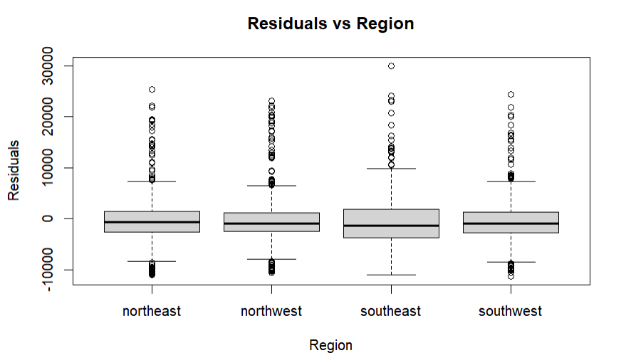
2. Independence Assumption
In this dataset the subjects are not related to time but lets check if spatial association exists.

Slide 21
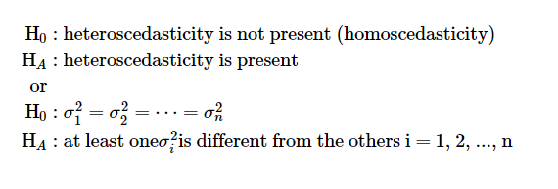
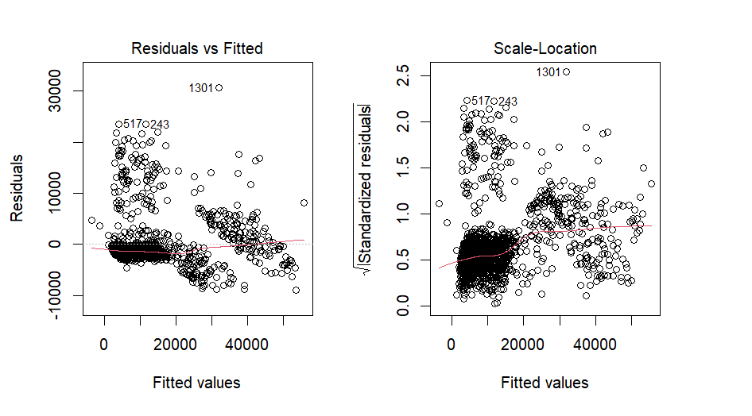
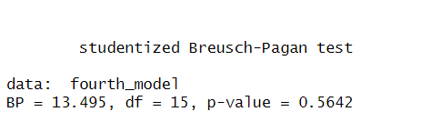
3. Equal Variance Assumption

Slide 22


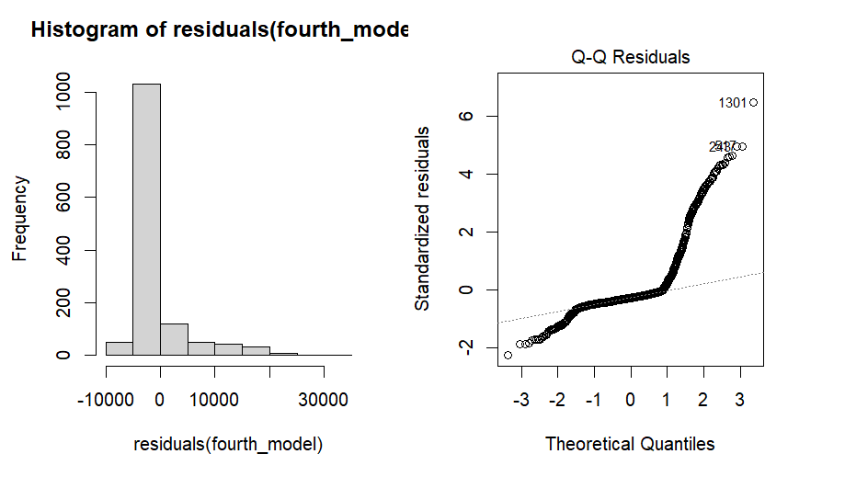
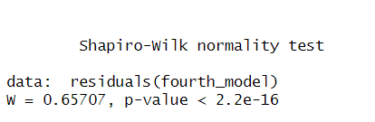
4. Normality Assumption

Slide 23
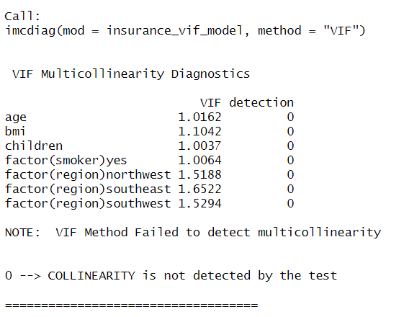
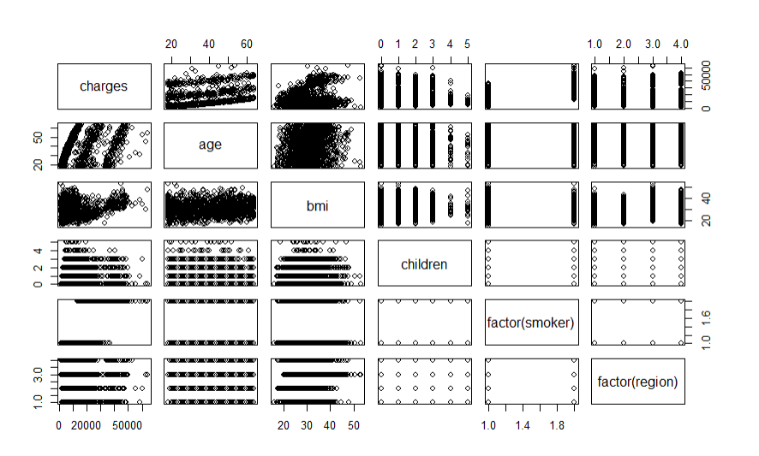
5. Multicollinearity Assumption

Slide 24
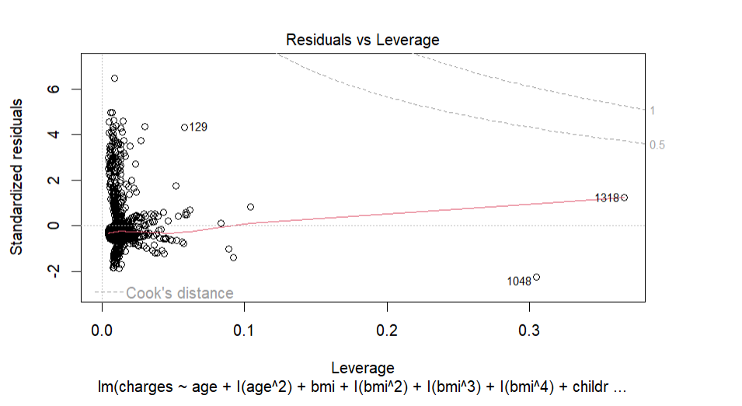
6. Outliers
Based on this plot everything looks okay. No influential Outliers detected

Slide 25
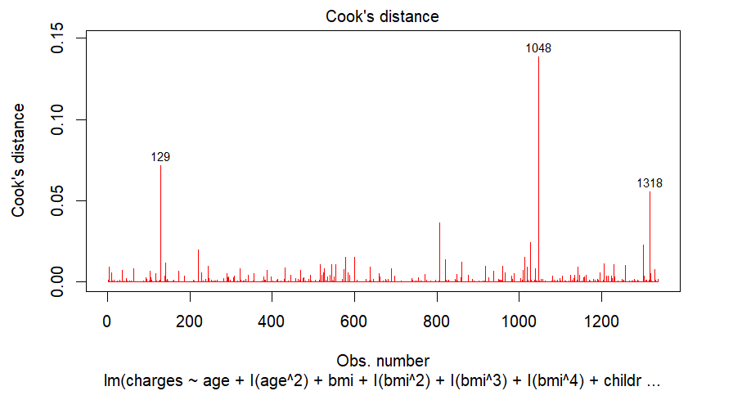
(Contd..)
Based on this plot there are no outliers in the Cook's distance.

Slide 26
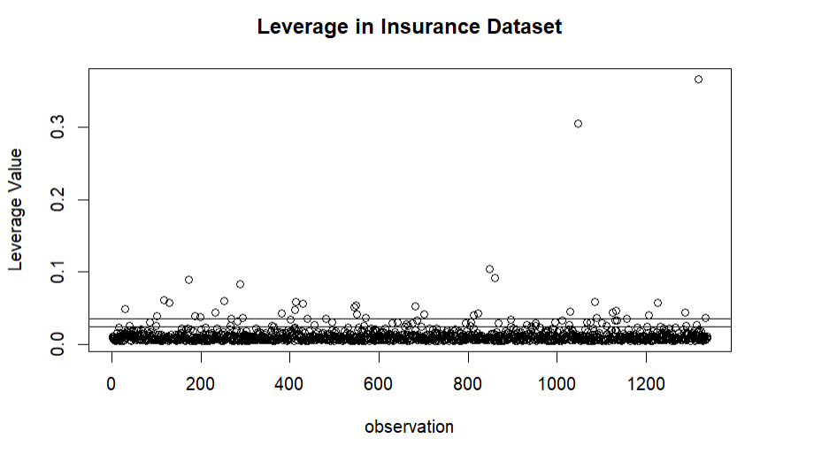
(Contd..)
We do not detect any outliers by using leverage values greater than 3p/n
Hence we can say there are no outliers that could pose problems.

Slide 27
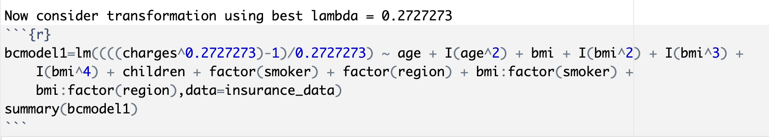
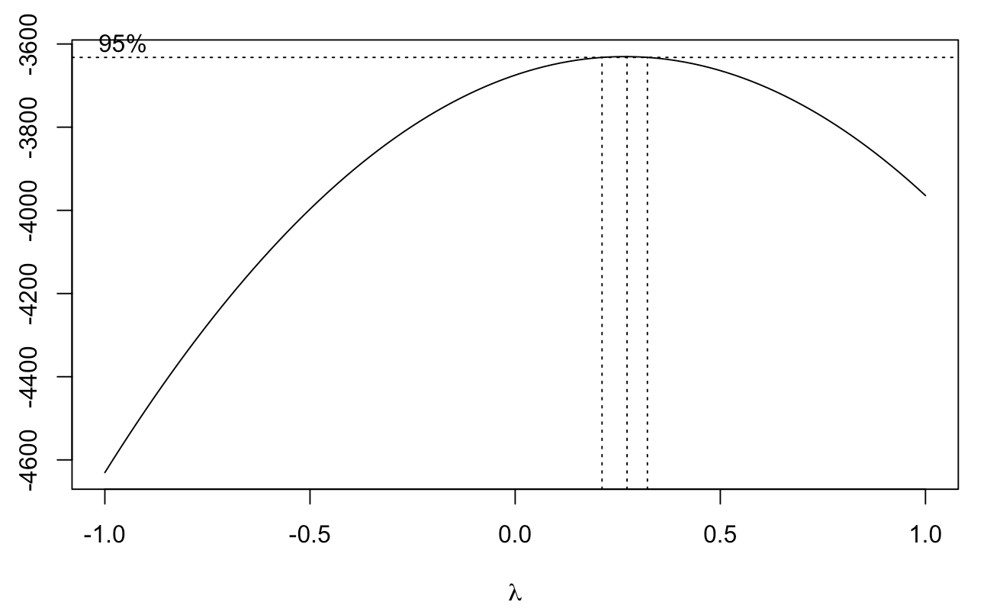
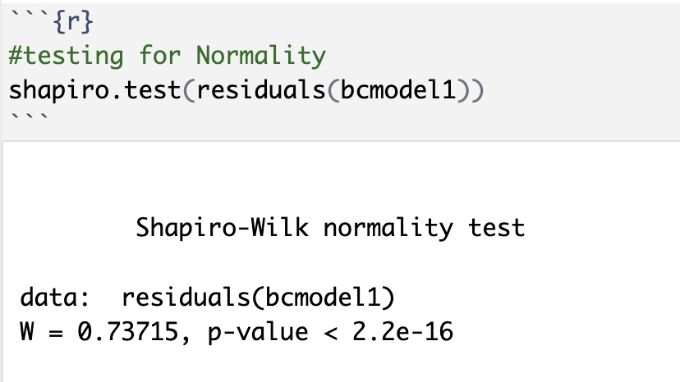
Part 5: Box-Cox Transformation

Slide 28
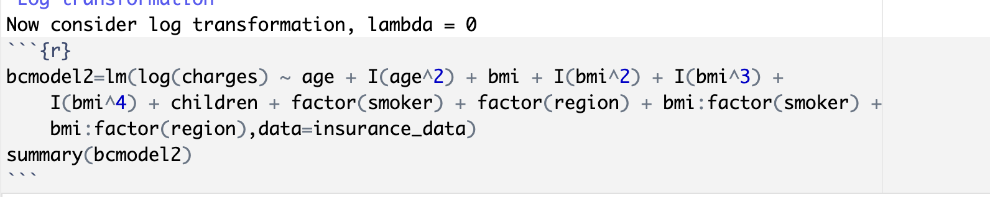
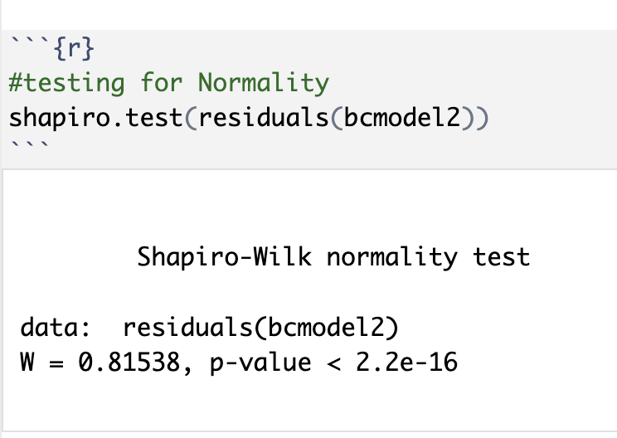
Log Transformation

Slide 29
BEST MODEL SUMMARY
MODELS | Adjusted_R2 | RMSE
Additive | 0.7495 | 6060.2
Interaction | 0.8405 | 4836.0
Higher Order | 0.8454 | 4760.7

Slide 30
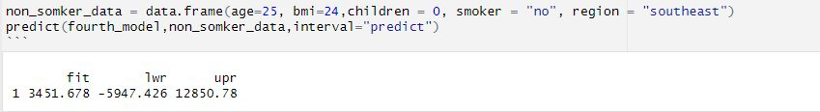
PREDICTING INSURANCE CHARGES
Scenario_1: (Present)
Our Dear friend Ahmed is planning on moving to the United Stated on January to start working as a Data Scientist.
Age:25, BMI:24, Smoking=No, Children= 0 and Region=Southeast

Slide 31
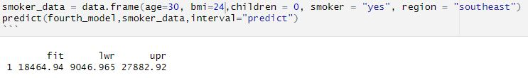
Scenario_2: (Future)
Ahmed is now: Age:30, BMI:24, Smoking=Yes, Children= 0 and Region=Southeast

Slide 32
REFERENCES
Medical Cost Personal Datasets. https://www.kaggle.com/datasets/mirichoi0218/insurance. Accessed 7 Dec. 2023.
10 Factors Affecting Life Insurance Rates – Forbes Advisor. https://www.forbes.com/advisor/life-insurance/factors-affecting-rates/. Accessed 7 Dec. 2023.
Health Insurance Statistics And Facts – Forbes Advisor. https://www.forbes.com/advisor/health-insurance/health-insurance-statistics-and-facts/#:~:text=Factors%20That%20Influence%20Health%20Insurance,of%20your%20health%20insurance%20plan. Accessed 7 Dec. 2023.

Slide 33
Thank You for listening!

